Slide 1
NYC Flights Exploratory Data analysis

Slide 2
Data Description – NYC Flights
 | Carrier | IATA
Mainline | Alaska Airlines | AS
 | Allegiant Air | G4
 | American Airlines | AA
 | Delta Airlines | DL
 | Frontier Airlines | F9
 | Hawaiian Airlines | HA
 | JetBlue Airways | B6
 | Southwest Airlines | WN
 | United Airlines | UA
 | Virgin America | VX
Regional | Endeavor Air | 9E
 | Express Jet | EV
 | Envoy Air | MQ
 | SkyWest Airlines | OO
 |  | US
 | Virgin America | VX
 | Mesa Airlines | YV
The Data set is if details of NYC flights of year 2013.
Flight Dataset have total 16 attributes.
Origin , Carrier , Month are basically categorical attributes.
Year , dep_delay , arr_delay discrete numerical values.
TailNum column is basically aircraft number which is like registration number of vehicles like car , two wheeler.
dep_time
sched_dep_time
dep_delay
arr_time
sched_arr_time
arr_delay
carrier
flight
tailnum
origin
dest
air_time
distance
hour
minute
time_hours
Origin Code | Airport Name
LGA | LaGuardia Airport
JFK | John F. Kennedy International Airport
EWR | Newark Liberty International Airport

Slide 3
Questions List
Which carrier has max number of flights overall and on particular airport.
How Departure delay vs Arrival delay related
How distance travelled and arrival delays relation
Which months is best for departures and arrival
Which are best carrier in terms of Arrival and Departure delays
Which are peek hours departure delays on NYCS airports
Which are the best airports in terms of departure delays
Which are the top 5 busiest Route
Finding the worst day of years based on departure delays on NYC airports

Slide 4
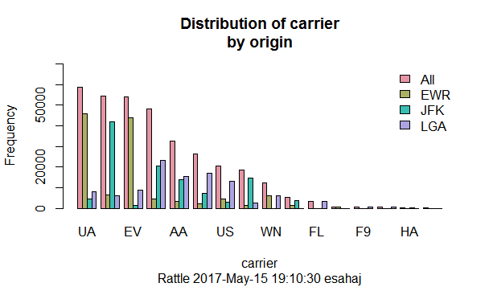
Distributive analysis
Results
On airport EWA the UA carrier has the maximum number of flights take off , On JFK airport the maximum number of flights taken off is of EV carrier
The UA carrier has the maximum number of flights taken off from all airports

Slide 5
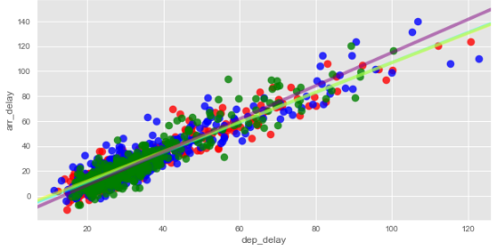
Dep delay vs arrival delay
Results
Linear graph depicting direct correlation between arrival and departure delay in minutes

Slide 6
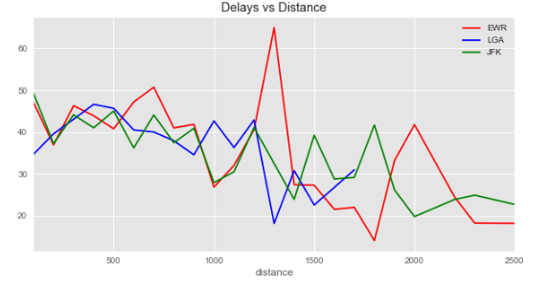
Distance and delays relation
Results
It shows that when distance is less delays are more but in case of long distance flight delays are very less.

Slide 7
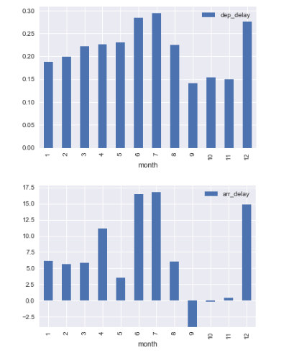
MONTHLY dep and arr delays
1
2
July is having maximum departure and arrival delays
June and Dec is the penultimate months for max arrival and departure delay

Slide 8
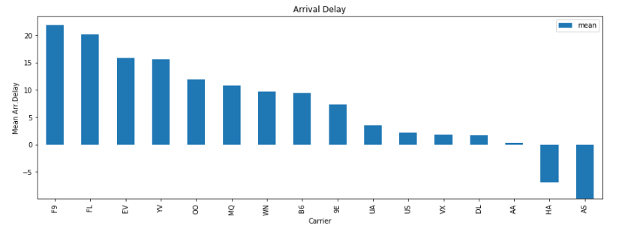
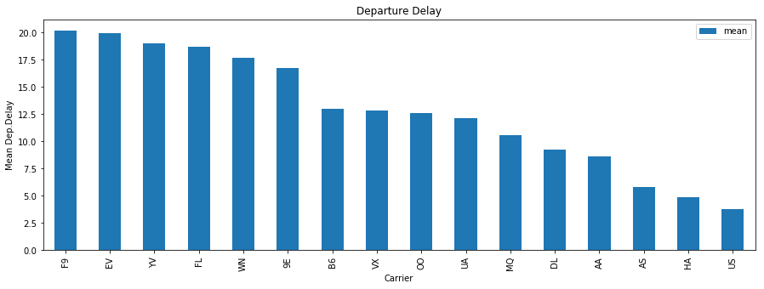
Best carrier based of arr/dep delay
Results
2
The best carrier is (AS) which has min mean delay
The worst carrier is (F9) which has the max mean delay
On time arrival is (AA) airlines
3

Slide 9
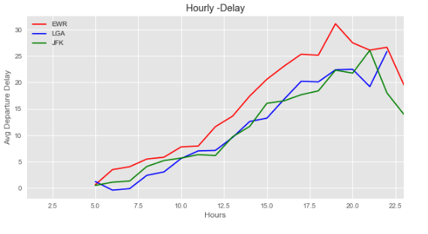
Peek hrs. Delay for flights departure
Results
Delay is worst during peak evening hrs. 1730 to 2015 Worst airport for delays is EWS

Slide 10
Best airport In terms of departure
Departure Airport | Mean Departure Delay
LGA | 41.63
EWR | 38.99
JFK | 38.05
Best Carrier based on arrival
Carrier | Mean Arrival Delay
LEX | -22
PSP | -12.722222
SNA | -7.868227
STT | -3.835907
ANC | -2.5
HNL | -1.365193

Slide 11
Top 5 busiest route
Departure | Destination | FREQ
JFK | LAX | 11262
LGA | ATL | 10263
JFK | SFO | 8204
LGA | CLT | 6168
Top worst day of year on airports
Date | Departure Airport | Mean Dep Delay on Day
9/2/2013 | LGA | 148.086957
3/8/2013 | LGA | 122.79798
3/8/2013 | EWR | 120.525346

Slide 12
Recommendation and conclusion
Recommendation | Best airport to travel is basically John Canady Airport
 | Best airlines to travel based is Alaska Airlines
 | Best time to travel in a day between 5AM to 7AM and while in between 1730 to 2015 the traveling not recommend.
Conclusion | Better knowledge of EDA
 | Better understanding of Numpy, Panda.
 | Betters understanding of statistics and matplotlib to plot different graphs

Slide 13
Thank You

